Slide 1
Getting Data for Analyics
Disha Parkhi

Slide 2
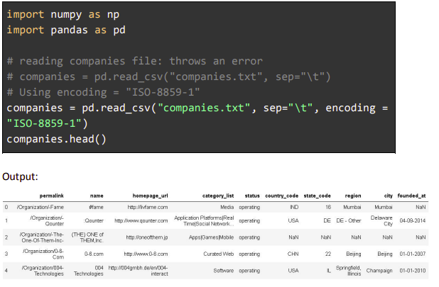
Getting Data From Text Files
The easiest way to read delimited files is by using pd.read_csv(file path, sep, header) and specifying a separator (delimiter)

Slide 3
Getting Data From a Relational Database
There are many libraries to connect MySQL and Python, such as PyMySQL and MySQLdb. All of these libraries follow the procedure mentioned below to connect to MySQL:
Create a connection object between MySQL and Python.
Create a cursor object (You can use the cursor to open and close the connection.).
Execute the SQL query.
Retrieve results of the query using methods such as fetchone() and fetchall().

Slide 4
Getting Data From Websites
Web scraping refers to the art of programmatically getting data from the internet
One of the best features of Python is that it makes it easy to scrape websites
In Python 3, the most popular library for web scraping is BeautifulSoup. To use BeautifulSoup, you need the requests module, which connects to a given URL and fetches data from it (in HTML format). A web page is HTML code, and the main use of BeautifulSoup is that it helps you parse HTML easily

Slide 5
Getting Data From APIs
Application programming interfaces or APIs are created by companies and organisations to provide restricted access to data. It is extremely common to get data from APIs for data analysis. For example, you can get financial data (stock prices, etc.), social media data (Facebook, Twitter, etc., provide APIs), weather data, data on healthcare, music, food and drinks, and data from almost every domain

Slide 6
Apart from being rich sources of data, the other reasons to use APIs are as follows:
When the data is getting updated in real-time: If you use downloaded CSV files, then you have to download data manually and update your analysis multiple times. However, through APIs, you can automate the process of getting real-time data.
Easy access to structured and verified data: Even though websites can be scraped manually, APIs can directly provide good-quality data in a structured format.
Access to restricted data: You cannot scrape all websites easily, as web scraping is usually considered illegal (For example, Facebook, financial data, etc.). APIs are the only way to access restricted data

Slide 7
Join the words in the address using a plus sign and convert them into a form words+in+the+address.
Connect to the URL by appending the address and the API key.
Get a response from the API and convert it into a Python object (here, a dictionary).

Slide 8
What after getting the data
After getting the data, import the data to python IDE
Get insights
Visualize the categorical, analytical and random data
Create the models for future predictions, classification etc.

